Slide 1

Support Vector Machine (SVM)
How to find the best line that separates two classes
Ananda Rimal
AI Researcher
Machine Learning Lecture
Ananda Rimal
(Machine Learning Lecture)
SVM
1/12

Slide 2

What is SVM?
Simple definition
SVM is a supervised machine learning algorithm. We give it labeled data of two classes, and it learns the best boundary that separates them. This boundary is called the hyperplane.
Why is SVM important?
▶
It does not pick just any boundary. It picks the safest one, which stays far from both classes.
It works very well when data has many features.
It needs only a few special points to make its decision, so the model is small and fast.
▶ ▶
Ananda Rimal
(Machine Learning Lecture)
SVM
2/12

Slide 3
Famous Real Life Examples
▶
Email spam filter
decides if a mail is spam or not spam
▶
Handwriting recognition
reading handwritten digits
▶
Face detection
decides if an image region is a face or not
Medical diagnosis
tumour is benign or malignant
▶
Bioinformatics
classifying proteins and genes
▶
Ananda Rimal
(Machine Learning Lecture)
SVM
3/12

Slide 4
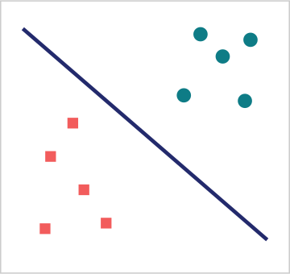
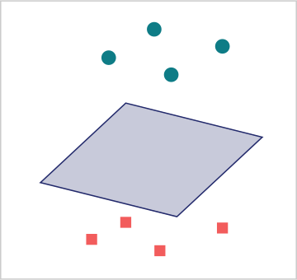
What is a Hyperplane?
The hyperplane is the boundary that separates the classes. Its shape depends on how many features the data has.
2D data (2 features)
3D data (3 features)
hyperplane = a LINE
hyperplane = a PLANE
▶ ▶ ▶
(2 features): the hyperplane is a line (3 features): the hyperplane is a plane
2D data
3D data
4D data and above
: we cannot draw it, but the same idea continues. That is why it is called a
hyp erplane
.
Ananda Rimal
(Machine Learning Lecture)
SVM
4/12

Slide 5
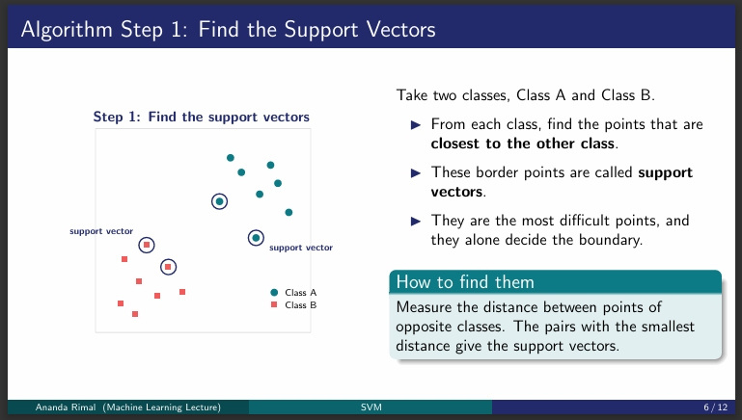

Slide 6
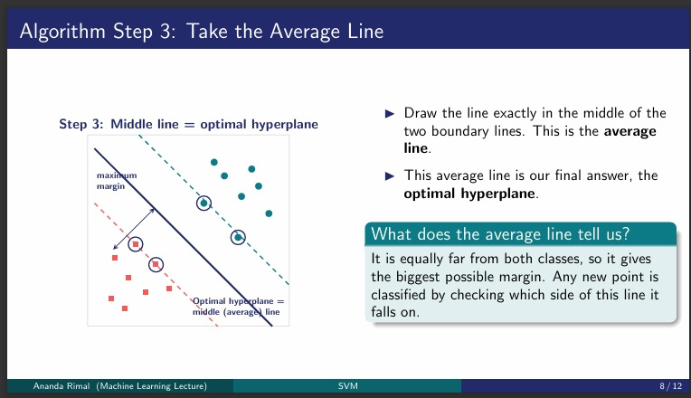

Slide 7

Problem: Sometimes a Line Cannot Separate
Here Class A sits in the middle and Class B sits on both sides.
1D data on a line:
x
B
B
B
A
A
A
A
A
B
B
B
x
Class A Class B
No single point can split them
→
NOT linearly separable!
The problem
No single point, and no straight line, can separate these two classes. Our step by step method fails here. We need a new idea.
Ananda Rimal
(Machine Learning Lecture)
SVM
9/12

Slide 8
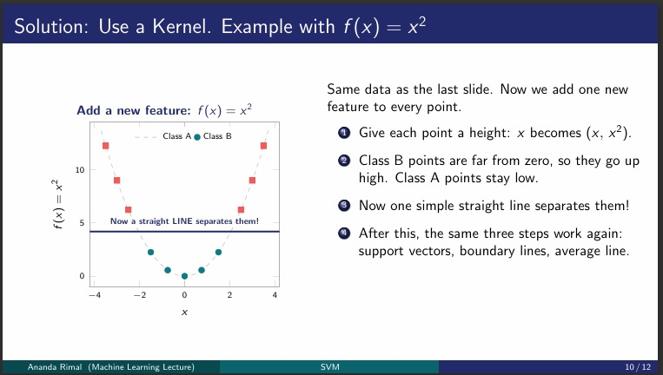

Slide 9
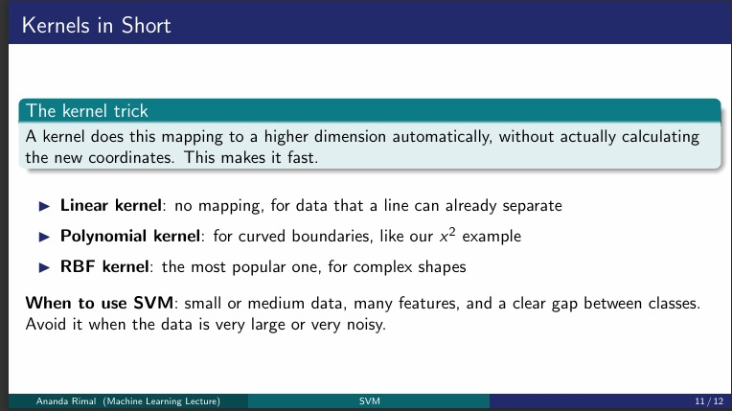

Slide 10
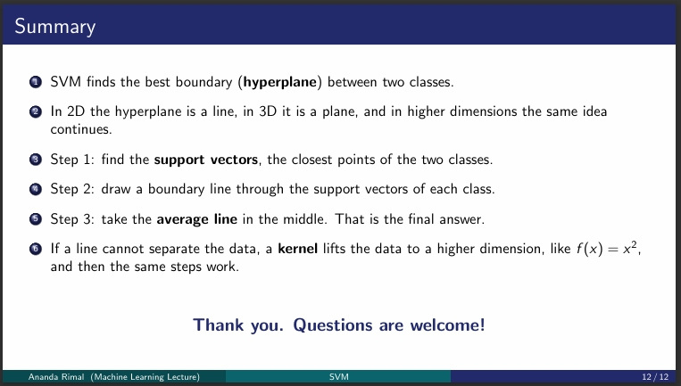

Slide 11
